Slide 1
Filter Design and Applications
ECE 480 - Team 3
Team Members:
Nate Kesto
Mike Mock
Justin Bohr
Yuan Mei
Xie He
Chaoli Ang

Slide 2
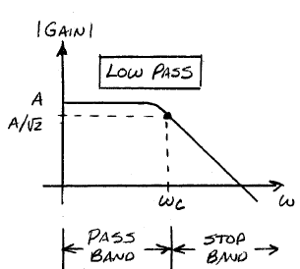
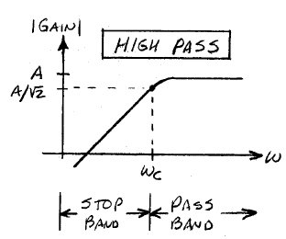
Outline
Introduction
Filter Designs
Low Pass
High Pass
Band Width
Band Pass
Differential Filtering
Filter Applications
Power Filtering
Audio Application
Band Stop
ECG Application

Slide 3
Introduction
Characteristics
Analog or Digital
Passive or Active
Linear or Non-Linear
Filter Types
Low Pass
High Pass
Band Pass
Band Stop

Slide 4
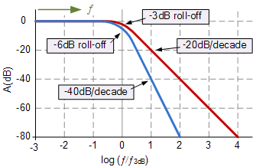
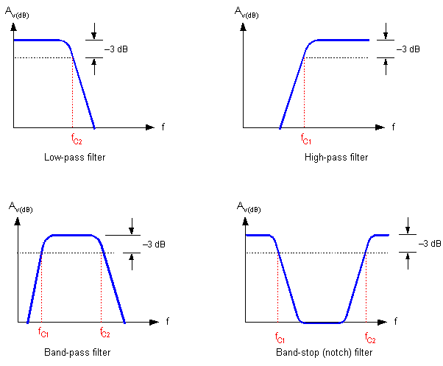

Filter Designs – Order and Cutoff Frequency
Order of filters
First order
Second order
Third and higher order
Cutoff frequency

Slide 5


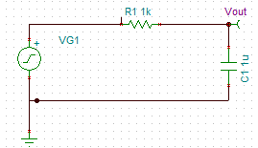
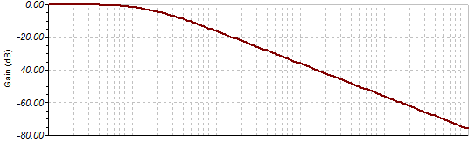
Filter Designs – Low Pass
Passive
Transfer function

Slide 6
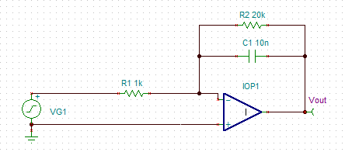



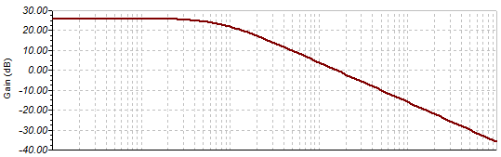
Filter Designs – Low Pass
Active

Slide 7
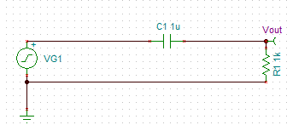
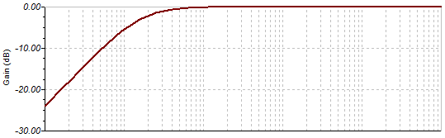


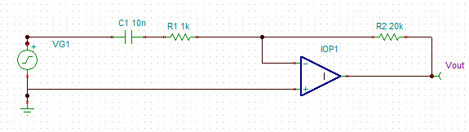
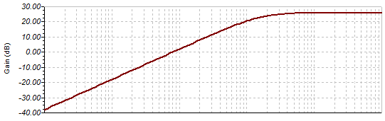


Filter Designs – High Pass
Passive
Active

Slide 8
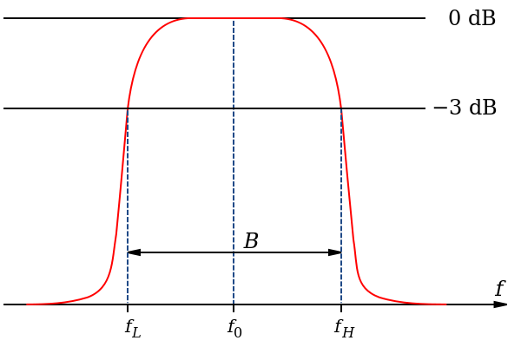
Filter Designs – Bandwidth
Bandwidth
Cutoff frequency and center frequency
Q factor

Slide 9
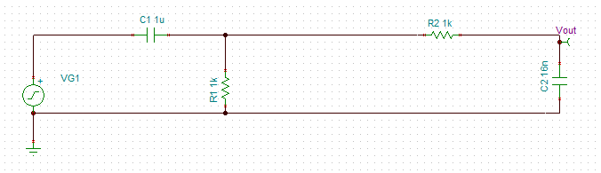
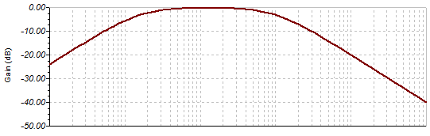

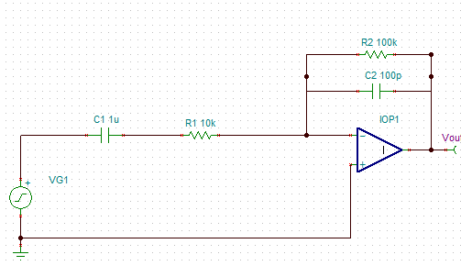
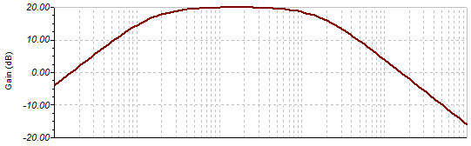

Filter Designs – Band Pass
Passive
Active

Slide 10
Filter Designs – Differential
Concepts：
Differential Filter: Any filter with a differential input and a differential output.
Single-Ended Signal：
-One of the signal terminals are grounded.
Differential Signal：
-Neither of the signal terminals are grounded.
Why do we need it ?
Couple with differential amplifiers.
Increase common mode rejection ratio, reduce noise and interference.

Slide 11
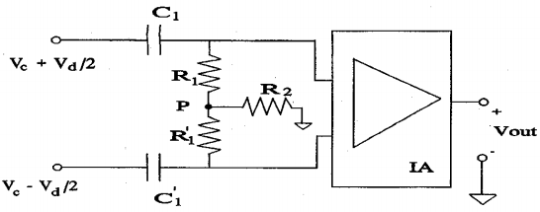
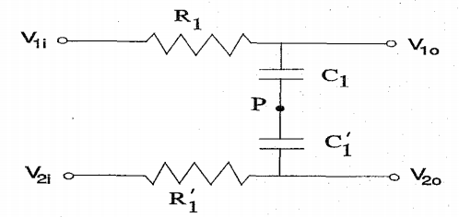
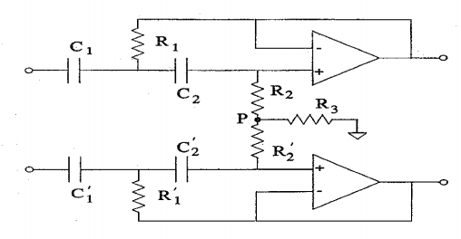
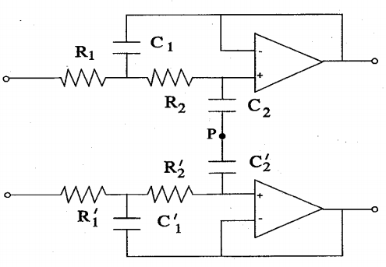
Filter Designs – Differential
Passive
High-pass Low-pass
Active
High-pass Low-pass

Slide 12
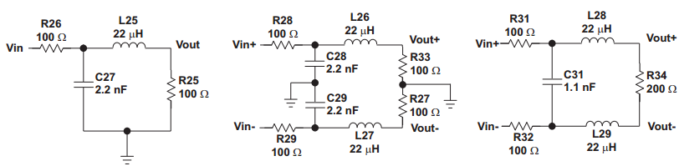
Filter Designs – Differential
How to design it？
Single-Ended to Differential-Ended Filter Translation.
Single-Ended LP Filter Differential LP Filter
*Figures from Texas Instruments Application Report “Design of Differential Filters for High-Speed Signal Chains” by Ken Chan

Slide 13
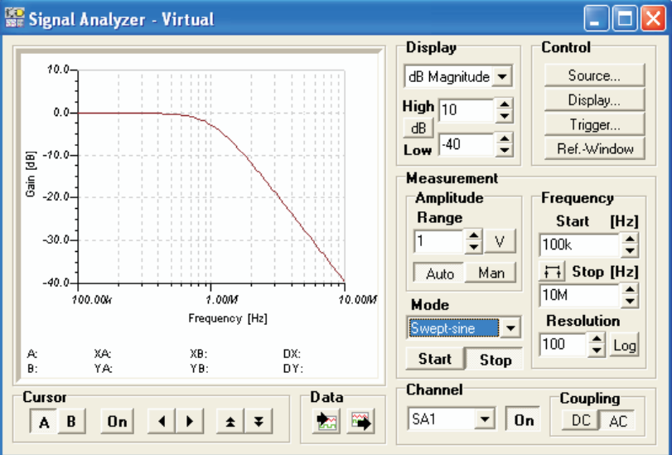
Filter Designs – Differential
Simulation result of both the Single Ended
and Differential filters using TINA-TI

Slide 14
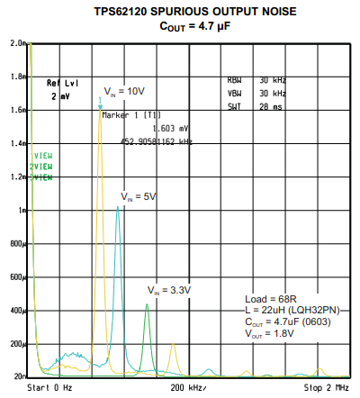
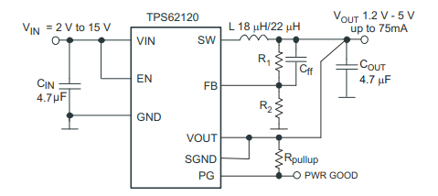
Filter Applications – Power
Buck Converter
Switched-Mode

Slide 15
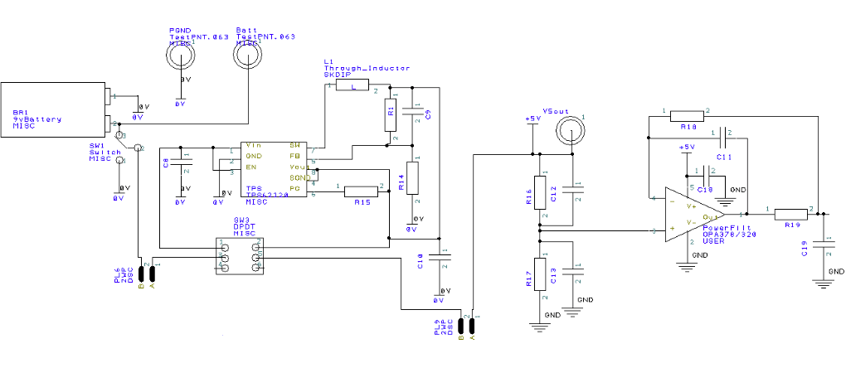
Filter Applications – Power
Power Filter

Slide 16
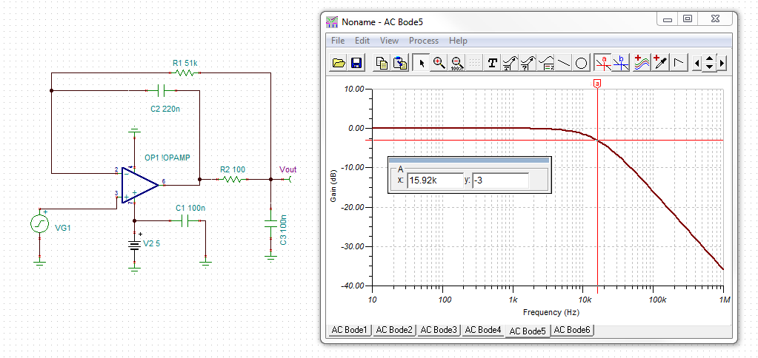
Filter Applications – Power
Tina – TI Simulation

Slide 17
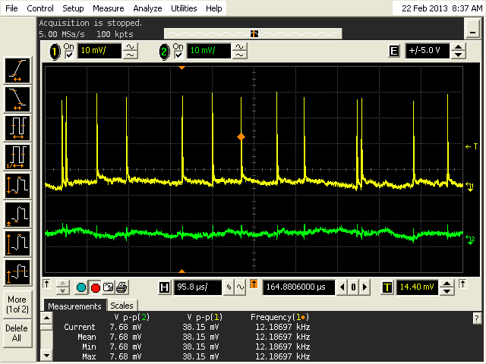
Filter Applications – Power
Results

Slide 18
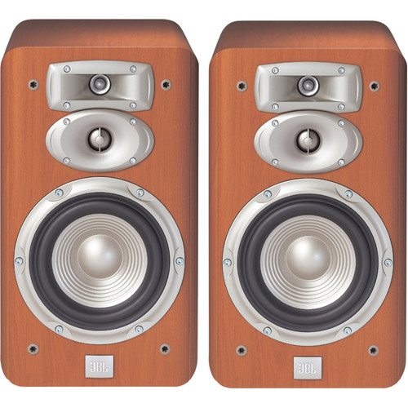
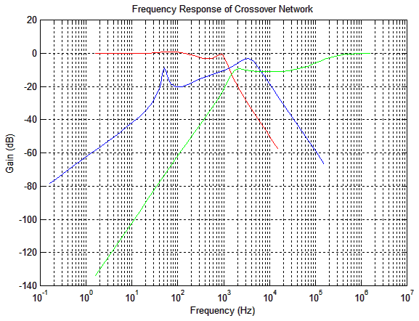
Filter Applications – Audio
3-way Speaker Crossover
Subwoofers (20 - 80Hz)
Midrange (80Hz - 2kHz)
Tweeter (2 - 20kHz)
Commercial 3-Way Speaker Pair
Bode Plot for 3-way Crossover
http://www.waldonell.com/thoughts/sticky-articles/designing-a-100w-3-way-speaker-system/

Slide 19
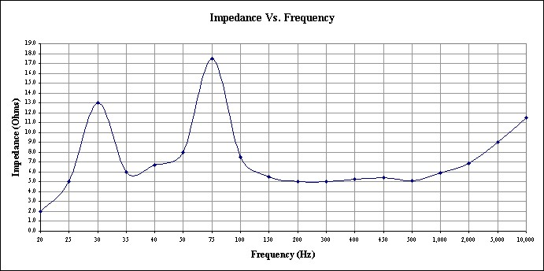
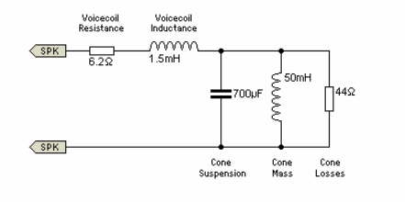
Filter Applications – Audio
Speaker Impedance vs. Frequency
Design Goal:
Match speaker’s natural frequency response with crossover
Maintain appropriate power distribution
Speaker Equivalent Circuit
http://fmarvasti.com/Graphics/Impedance.jpg
http://sound.westhost.com/tsp.htm

Slide 20
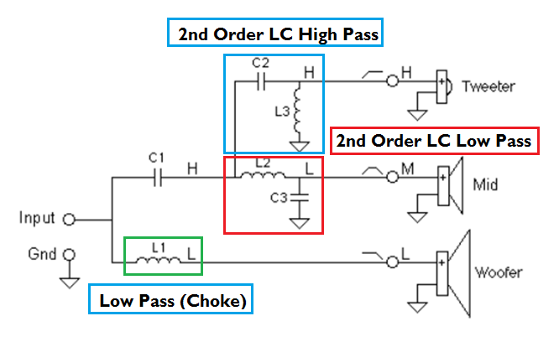
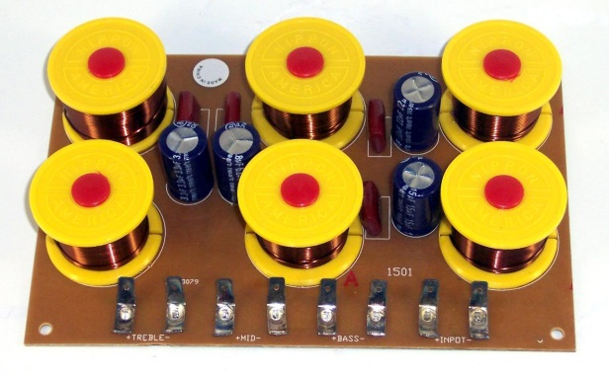
Filter Applications – Audio
Speaker Crossover Schematic
Passive Elements (RLC Networks)
http://www.trueaudio.com/st_xov_1.htm

Slide 21
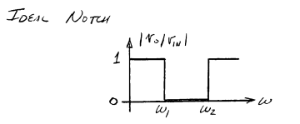
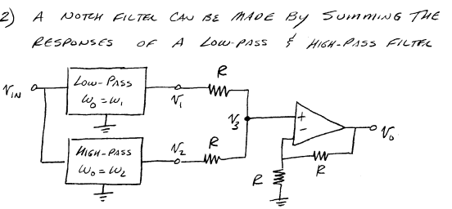
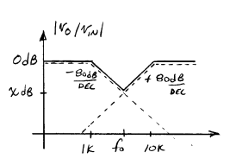
Filter Designs – Band Stop
Background
Analog design
Digital design
Notes:
Band stop filter is a filter that passes most frequency but attenuates those in a specific range to very low levels.
A notch filter is a band-stop filter with a narrow stop band (high Q factor). In our case, we need to eliminate the mains hum, which is an audible oscillation of AC at the frequency of the mains electricity at 60 Hz. So our notch frequency is 60 Hz. The reason we choose the digital design is that notch filter has side effect on the ECG signal when the voltage gain slope is not -40dB/decade, part of ECG signal will be distorted, so in our project we use digital design to make sure notch filter has accurate slope at -40 dB/decade

Slide 22
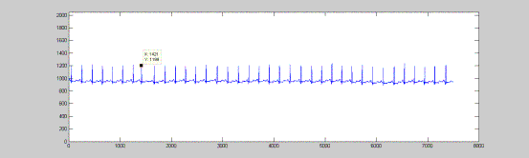
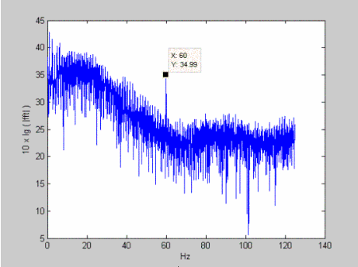
Filter Applications – Band Stop
Notes:
Picture 1 is the ECG signal; When we analyze these spectrum, especially when we zoom in, we can see the 60 Hz power noise; To erase the 60 Hz power noise, we need to use the Notch filter to eliminate the signal at 60 Hz.

Slide 23
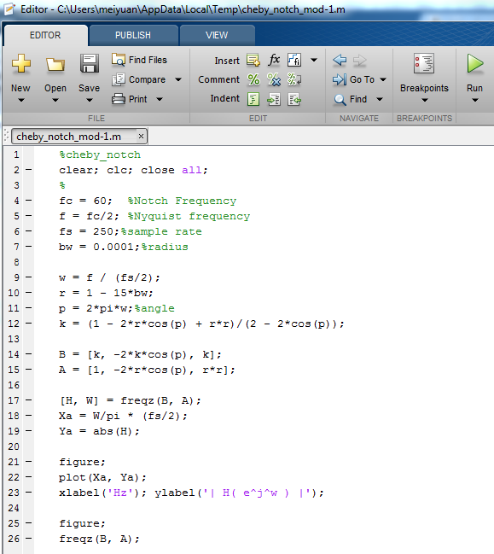
Filter Applications – Band Stop
Notch Filter by Matlab

Slide 24
Filter Applications – Band Stop
Plot of the Notch Filter

Slide 25
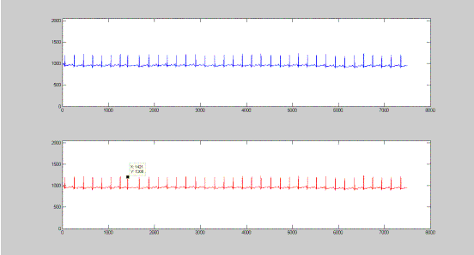
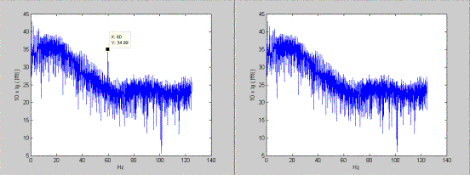
Filter Applications – Band Stop
Notes:
After Notch filter, we can see that the ECG signal is cleaner and 60 Hz power noise is erased

Slide 26
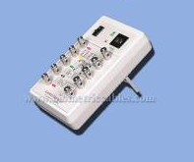
Filter Applications – ECG
Band Pass
f₀ = .7 Hz
f₁ = 50 Hz
Stellaris Oscilloscope
AFE

Slide 27
Filter Applications – ECG
Inverting Low Pass
Low Pass
Low Pass
Servo Loop
Input Filtering
INA333
Post Filtering
Stellaris Oscilloscope
CardioSim II
RLD
Inverting High Pass

Slide 28
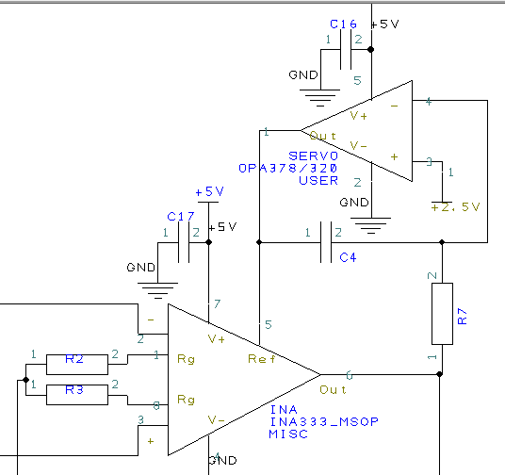
Filter Applications – ECG
Servo Loop
Inverting Low Pass filter
Output sent to Reference pin of INA
Effective High Pass

Slide 29
Questions?

